Slide 1
How to log on to AstroHub

Slide 2
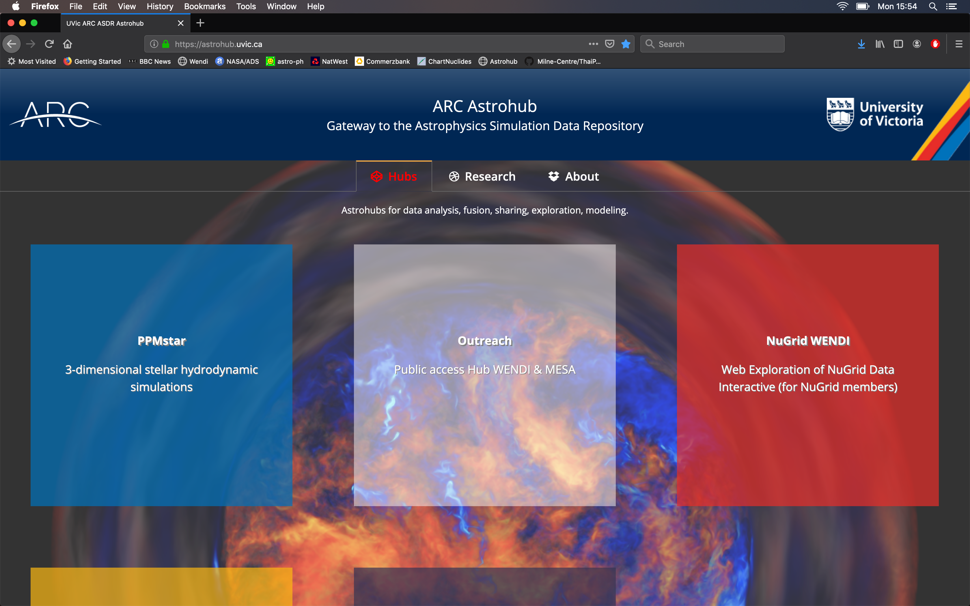
CLICK HERE!
Go to https://astrohub.uvic.ca
Click on the big box marked “Outreach”

Slide 3
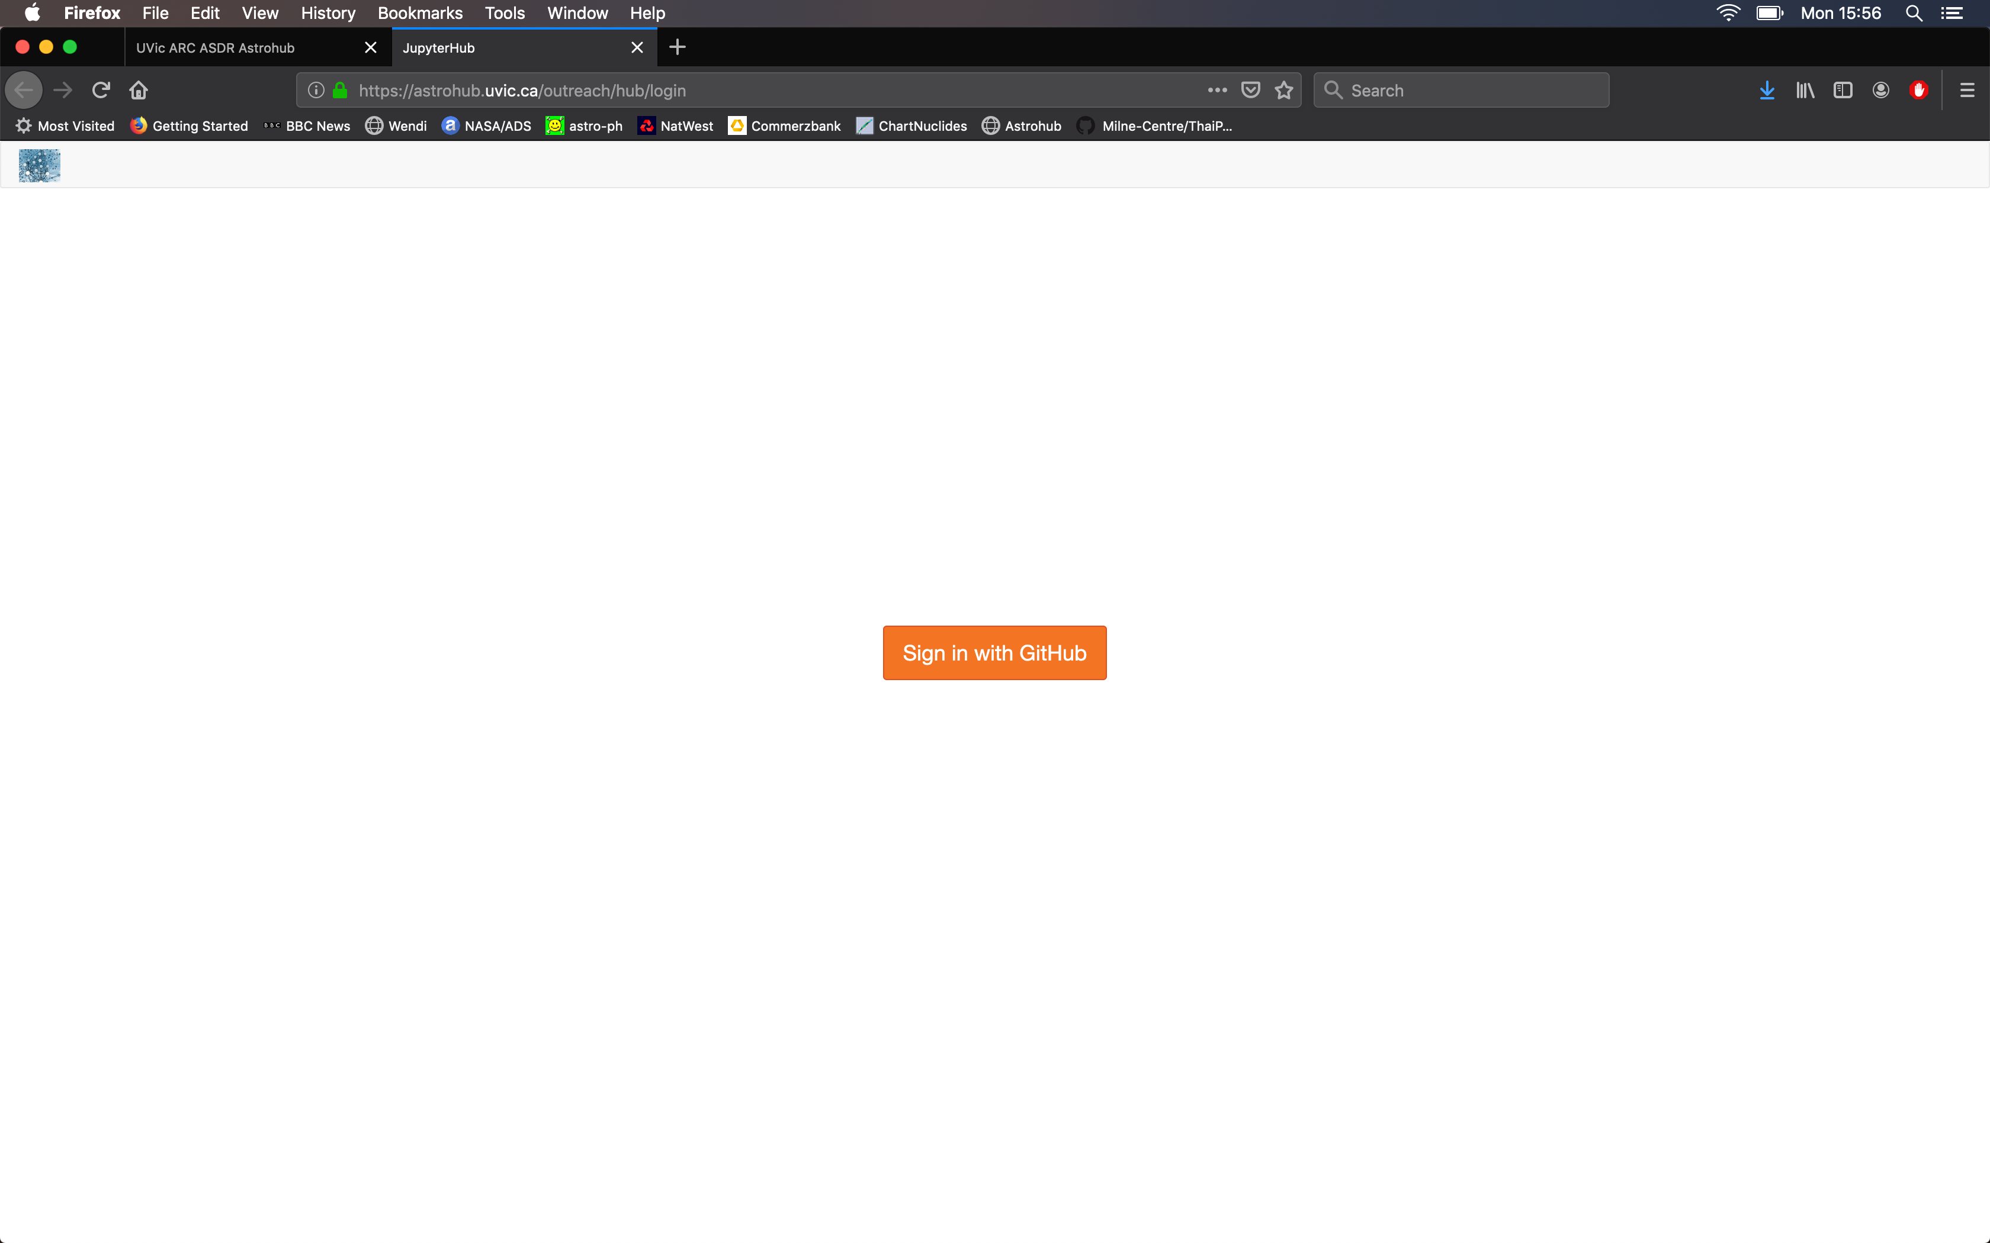
Use your GitHub account to sign in

Slide 4
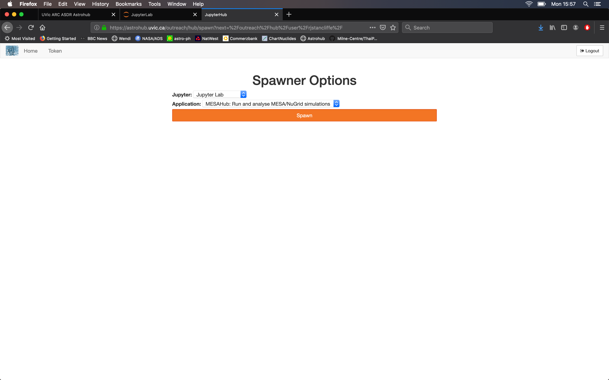
Choose “JupyterLab” from the options
Choose “MESAHub:Run and analyse MESA/NuGrid simulations
Click the Spawn button

Slide 5
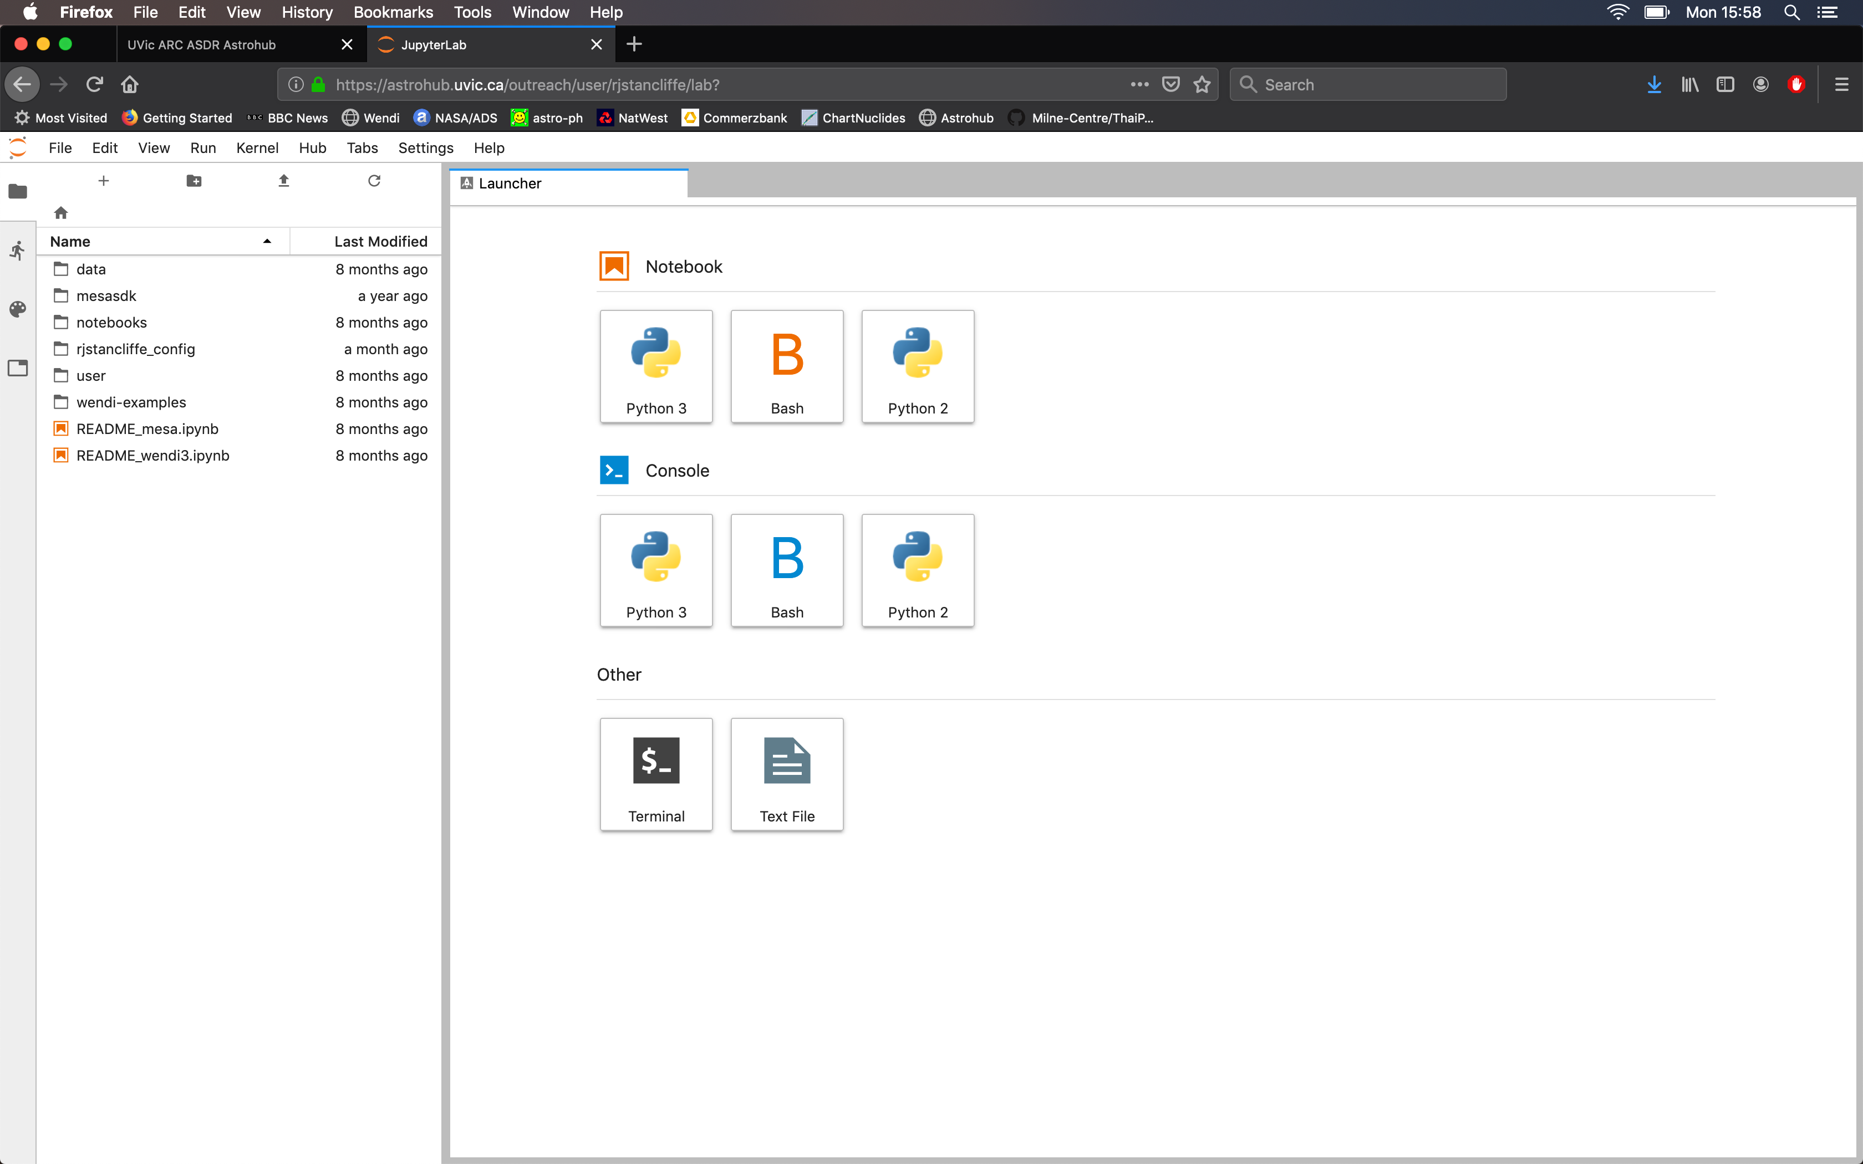
Use this to upload
Upload the StarsAndAtomsExercise.ipynb file from your machine using the upload icon

Slide 6
You can now double click the .ipynb file to run it.
WORDS OF WARNING!
The notebook will not remain when you log out – manually copy your cells to an open notebook on your own machine
The kernel (the thing that runs the Python) sometimes stops. When you restart it, you will need to run ALL your cells again.

